Slide 1
Lecture 10
Web Programming
Ajax & Cookies
Mahhek Tahir
Notes:
html

Slide 2
What is Ajax?
AJAX (Asynchronous JavaScript and XML)
Allows web pages to update asynchronously without reloading.
Uses JavaScript to send/receive data from a web server.
Often works with JSON instead of XML.

Slide 3
How Ajax Works
User triggers an event (e.g., clicking a button).
JavaScript creates an XMLHttpRequest (XHR) object.
XHR sends a request to the server.
Server processes the request and sends a response.
JavaScript updates the web page dynamically.

Slide 4
Ajax-driven Online Applications
Gmail
Google Maps
Google Docs
YouTube
Facebook
Instagram

Slide 5
Advantages of Ajax
Improved User Experience: AJAX allows for smoother and faster interactions because it only loads the necessary parts of the page.
Asynchronous: AJAX calls are asynchronous, meaning the page can continue to function while waiting for a server response.
Reduced Server Load: By only requesting necessary data rather than reloading entire pages, server resources are used more efficiently.

Slide 6
Basic Steps of Ajax
Create an XMLHttpRequest object: This is the main object used for making requests to the server.
Configure the request: You set the request type (GET, POST, etc.), the URL to send the request to, and whether it should be asynchronous.
Send the request: Once the request is set up, it is sent to the server.
Process the response: When the server sends back a response, you can use JavaScript to process and update the page dynamically based on that response. What is response?

Slide 7
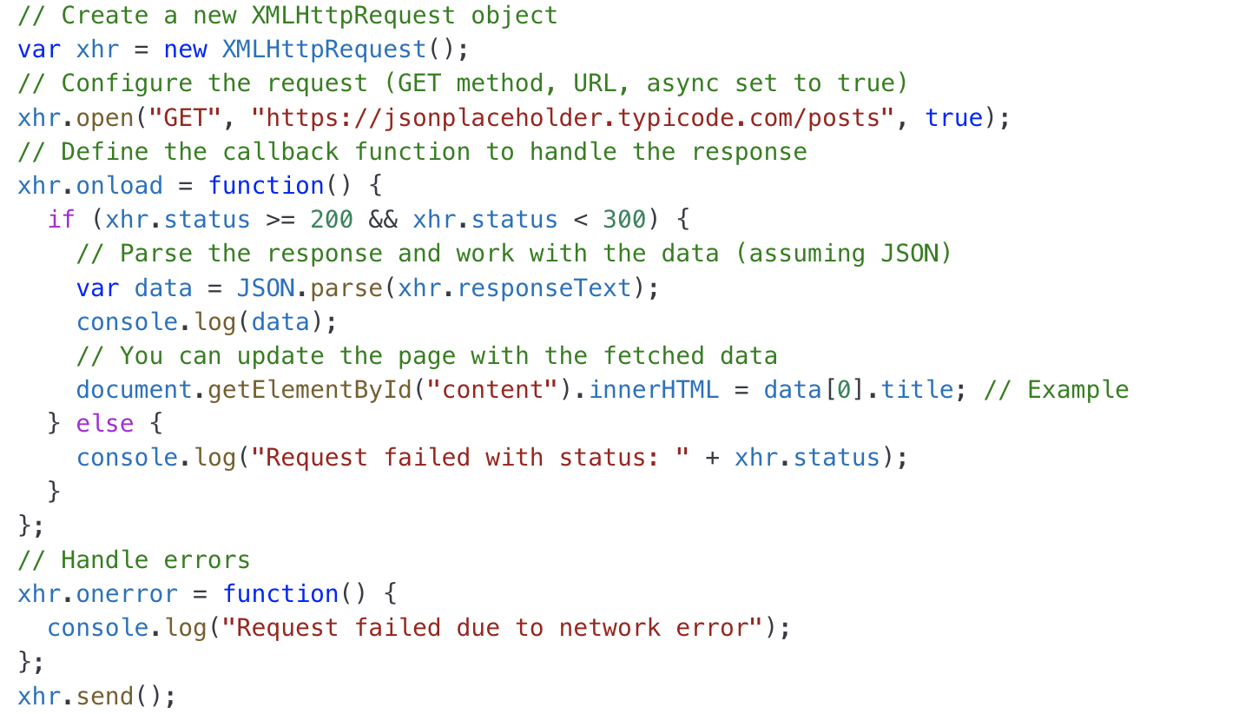
Ajax Example with JS

Slide 8
Ajax Example with JS
Explanation of the Example:
xhr.open("GET", "URL", true);: Initializes the request. "GET" specifies the type of request, and "true" makes it asynchronous.
xhr.onload: This function runs when the response is received from the server. If the status is successful (status code 200-299), the response is processed.
xhr.send();: Sends the request to the server.

Slide 9
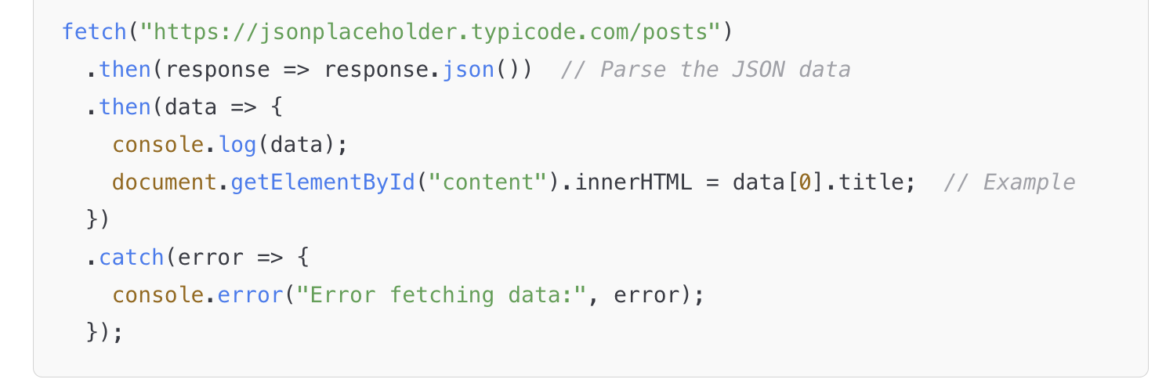
Ajax with Fetch API
The Fetch API is a modern alternative to XMLHttpRequest. It’s more flexible and easier to use. Here's how the previous example would look using the Fetch API: API END POINT?

Slide 10
Common Uses of Ajax
Form Submissions: Sending form data without reloading the page.
Live Search: Updating search results as you type.
Updating Content: Loading content like news or product listings dynamically.
Single-Page Applications (SPAs): Frameworks like React, Angular, and Vue rely heavily on AJAX for updating the user interface without page reloads.

Slide 11

JavaScript and Cookies
Baking Your First Cookie!

Slide 12
JavaScript and Cookies
In web terms, a cookie is a unique chunk of information that a web server gives to a browser when the first meet.
Browsers saves the cookie and information about you as a plain text file stored on your computer’s drive.
You can keep track of which parts of your site the user has visited and count the number of visit from the user.

Slide 13
Introduction to Cookies
Cookies are small pieces of data stored on the client’s browser.
Used for tracking, session management, and personalization.
Stored as key-value pairs.

Slide 14
Type of Cookies
Session Cookies: Expire when the browser is closed.
Persistent Cookies: Remain stored until they expire or are deleted.
Secure Cookies: Transmitted only over HTTPS.
HttpOnly Cookies: Cannot be accessed by JavaScript.

Slide 15
How Cookies Work?
Server sends a Set-Cookie header in the HTTP response.
Browser stores the cookie.
Browser includes the cookie in subsequent requests.
Server reads the cookie for session management.

Slide 16
Set and GET Cookie using JS
Set a Cookie
document.cookie = "username=JohnDoe; expires=Fri, 31 Dec 2025 23:59:59 UTC;";
Get a Cookie
console.log(getCookie("username"));

Slide 17
Misconception about cookies
Cookies store viruses or malware: False, cookies are just text files and cannot execute code.
Cookies are always bad for privacy: Not necessarily, they can enhance user experience when used responsibly.
Deleting cookies removes all tracking: Not entirely, as other tracking mechanisms like local storage and fingerprinting exist.
Cookies slow down your browser: Only if excessive cookies are stored, but modern browsers manage them efficiently.

Slide 18
Revision?

